Slide 1
Software Engineering
Software Design
Unified Modelling Language
Class Diagrams
Learning Outcomes
  Be able to identify classes from a problem description
  Be able to create class diagrams from a description of a problem
  Understand and be able to apply the constructs of a class diagrams

Slide 2
Objects
The object-oriented approach to system development is based on the concept of objects that exist within a system’s environment.
Objects are everywhere
An object is something that is or is capable of being seen, touched, or otherwise sensed, and about which users store data and associate behaviour.
The types of objects may include a person, place, thing, or event.
  An employee, customer and student are examples of person objects.
  A particular warehouse, office, building, and room are examples of place objects.
  A product, vehicle, piece of equipment, video tape, or a window appearing on a users display monitor are examples of thing objects.
  An order, payment, invoice, application, registration, and reservation are examples of event objects.

Slide 3
Attributes
In OO the term “data” refers to what are called attributes.
  Attributes are the data that represent characteristics of interest about an object.
  Example attributes for the person class called customer:
    customer id, first name, last name, home address, work address, type of customer, home phone, work phone, credit limit, available credit, account balance, and account status.
  Each individual customer object is referred to as an object instance.
    An instance (or object instance) of an object consists of the values for the attributes that describe a specific person, place, thing, or event.

Slide 4
Methods
AKA - Operations, behaviour, services
What is the “behaviour” of an object?
  Behaviour refers to those things that the object can do and which correspond to functions that act on the object’s data (or attributes).
  In OO, an object’s behaviour is commonly referred to as a method
  An object is solely responsible for carrying out any functions or behaviours that act upon its own data (or attributes).
    For example, only YOU (an object) may CHANGE (behaviour) your HOME ADDRESS and TELEPHONE NO. (attributes about you).

Slide 5
Encapsulation ( Information Hiding)
Encapsulation is the packaging of several items together into one unit.
Both attributes and methods of the object are packaged together.
The only way to access an object's attributes is through that object’s behaviours.
No other object may perform that object’s operations
Separate external, visible aspects of an object from its internal implementation detail. This allows implementation to be changed without affecting the applications that use it.

Slide 6
Classes
A class is a set of objects that share common attributes and behaviour.
  For example, chair and table objects represent thing-objects that have some similar attributes and behaviour and could be classified as FURNITURE.
Using UML notation, classes are represented on an object model as a rectangle.
  The rectangle is divided into three sections.
    The top section contains the name of the class.
    The middle section contains the name of the common attributes of interest.
    The lower section contains the common behaviour (or methods).

Slide 7
Classes - example
Lecturer Fred
Name=Fred
Room 16J03
Salary=10000
Class Lecturer
Attributes
Name
Room no.
Salary
Lecturer Laura
Name=Laura
Room 16J15
Salary=15000
Methods
Lecture()
Mark()
Publish()
...
Instances of the class Lecturer
i.e. objects

Slide 8
Classes and Objects
Document static structure of the system
Identify classes that should exist in system
  Identify candidate classes - noun identification and noun phrases
  Requirements specification required
  Can also be sought from Use-Case Flow of Events
Classname
OR
Class Name
Attributes
Methods/
functions/
behaviour

Slide 9
Class associations
An class association is an relationship that exists between one or more objects/classes.
  For example, consider the object classes customer and order
  a CUSTOMER PLACES zero or more ORDERs
    an ORDER IS PLACED BY one and only one CUSTOMERs
We graphically illustrate the association(relationship) between two classes as a connecting line.
  Verb phrases describe the relationship.
  All relationships are implicitly bi-directional
  Multiplicity defines the minimum and maximum number of occurrences of one object/class for a single occurrence of the related object/class.
  Because all relationships are bi-directional, multiplicity must be defined in both directions for every relationship.
Places
0..*
Customer
Order

Slide 10
Multiplicity
1
Class name
means one and only one
0..*
Class name
means zero or more
0..1
Class name
means zero or one
1..*
Class name
one or more

Slide 11
Associations
An Association
teaches
Lecturer
Course
1..*
teaches
0..*
Lecturer
Course
Is taken by

Slide 12
A class may be attached to an association rather than directly to another class.
Such a class is called an Association Class. It can have data attributes and behaviour just like any other class
Used to hold information on each occurrence of a relationship
Supplies
Supplier
Part
Contract
Date

Slide 13
Another Example
1..*
Is taking
6
Student
Module
Mark
Mark: int

Slide 14
Aggregation Association
objects/classes can be made up of other objects/classes. This relationship is called aggregation.
  It is also sometimes known as “whole-part” or “part-of” relationships.
For example, a BOOK object may contain several objects, including: COVER, TABLE OF CONTENTS, CHAPTER, and INDEX objects.
  The CHAPTER object contains PAGE objects, which in turn contain PARAGRAPH objects, which in turn contain WORD objects, and so forth.
By identifying aggregation relationships we can partition a very complex object and assign behaviours and attributes to the individual objects within it.
Multiplicity is also specified for aggregate relationships

Slide 15
Book
Cover
Table of
Chapter
Index
Contents
Page
Aggregate
Relationship
Paragraph
Word

Slide 16
Inheritance
Inheritance implies that methods and/or attributes defined in an class can be inherited or reused by another class.
The approach that seeks to discover and exploit the commonalties between objects/classes is referred to as generalisation and specialisation.
  Generalisation/specialisation
    attributes and behaviours that are common to several types of an object classes are grouped into their own class, called a supertype. Supertypes are generalisations of subtypes. Subtypes are specialisations of supertypes.
    In the object class PERSON, STUDENT and PROFESSOR example, PERSON is referred to as a supertype (or generalisation class) whereas STUDENT and PROFESSOR are referred to as subtypes (or specialisation class).

Slide 17
Person
last name
first name
walk
Supertype and
Subtype relationship
Between object classes
sleep
talk
eat
Student
Professor
rank
Classification
Student ID
enrol
lecture

Slide 18
Example - Problem Statement for ATM
Design the software to support a computerised banking network including both human cashiers and automated teller machines (ATMs) to be shared by a consortium of banks. Each bank provides its own computer to maintain its own accounts and process transactions against them. Cashier stations are owned by individual banks and communicate directly with their own bank computers. Human cashiers enter account and transaction data. ATM’s communicate with a central computer which clears transactions with the appropriate banks. an ATM accepts a cash card, interacts with the user, communicates with the central system to carry out the transaction, dispenses cash and prints receipts. The system requires appropriate record keeping and security provisions. The system must handle concurrent accesses to the same account correctly. The banks will provide their own software for their their own computers; you are to design the software for the ATM’s and the network. The cost of the shared system will be apportioned to the banks according to the number of customers with cash cards.
Ref: Raumbaugh et al. Object Oriented Modeling and Design, Prentice Hall, 1991.

Slide 19
The Class Diagram
Identifying classes
  From the nouns in the problem statement
  Eliminate the
    redundant
    irrelevant - those unrelated to the problem
    Vague - ill-defined boundary, very broad in scope
    attributes - things that describe an object
    operations - things that manipulate objects
    implementation constructs - extraneous to real world must be eliminated from analysis model, needed during design, but not now.

Slide 20
Object Modeling - Identifying Classes
e.g. ATM system - Potential Object List
  Software Central Computer
  Banking Network Cash Card
  Cashier User
  ATM Cash
  Consortium Receipt
  Bank Computer System
  Account Recordkeeping provision
  Transaction security provision
  Cashier station Access
  Account data Cost
  Transaction Data Customer

Slide 21
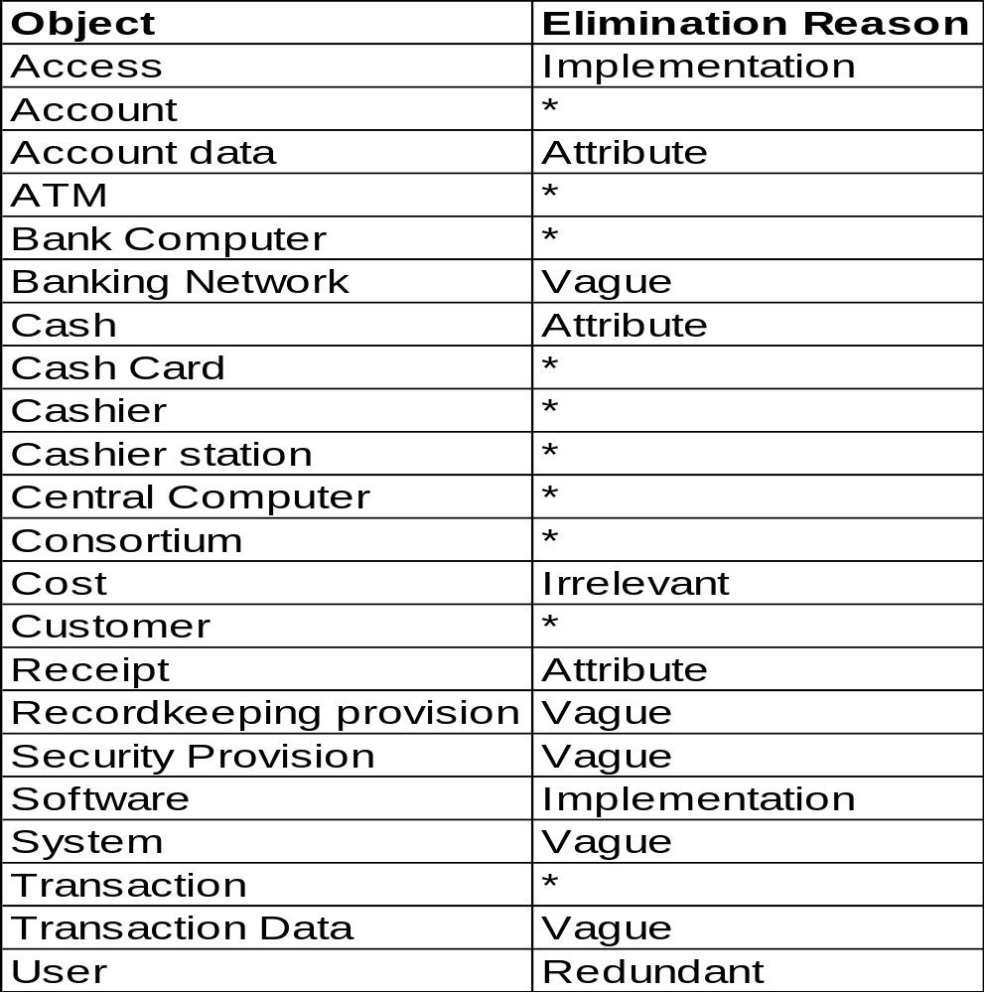
Object Modeling -Keeping the right classes
KEEP:
Account,
ATM,
Bank,
Bank Computer,
Cash Cards,
Cashier,
Cashier Station,
Central Computer, Consortium, Customer,
Transaction

Slide 22
Object Modeling - Data Dictionary
Prepare a Data Dictionary/Description of each class
  Account - a single account in a bank against which transaction can be applied. Accounts may be of various types, at least checking or saving. A customer can hold more than one account.
  ATM - a station that allows customers to enter their own transactions using cash cards as identification. The ATM interacts with the customer to gather transaction information, sends the transaction information to the central computer for validation and processing, and dispense cash to the user.
  Bank - ………….

Slide 23
ATM - Identify Associations
  Associations correspond to verbs in the problem statement
  Association = any dependency between two classes
  form verb phrases involving identified classes
    consortium shares ATMs
    bank provides bank computer
    bank computer maintains accounts etc...
  or from implicit verb phrases
    consortium consists of banks
    bank holds account etc...
  or from knowledge of the problem domain
    cash card accesses accounts
    bank employs cashiers

Slide 24
Initial Class Diagram
0..*
Has
Customer
Consortium
Consists of
Bank
Holds
0..*
Account
Concerns
Owns
Owns
Accesses
Owns
0..*
Employs
Central Computer
0..*
Bank Computer
0..*
Cashier
Concerns
Communicates
Communicates
Entered
with
with
0..*
0..*
0..*
Has
Communicates
0..*
Cashier transaction
Cashier Station
with
0..*
Entered On
0..*
0..*
ATM
Remote transaction
0..*
Cash Card
0..*
Entered On
Authorised by

Slide 25
Further Specify the semantics of associations
Include Multiplicity
Qualifier or Qualified Associations
  Usually a name identifies an object within some context; most names are not globally unique. The context combines with the name to uniquely identify the object.
  A Qualifier distinguishes objects on the many side of an association. For example, a qualifier bankcode could be added to distinguish the different banks in a consortium. Each cash card needs a bank code so that transactions can be directed to the appropriate bank.
Bank
bankcode
Consortium

Slide 26
Identifying Attributes and operations
Attributes
  Properties of an individual object
  Usually possessive phrases e.g. the colour of the car
  Identify from the problem description and domain knowledge
Operations
  Define ways in which objects interact

Slide 27
Identifying Attributes
0..*
0..*
Holds
Has
Customer
Consortium
Bank
0..*
Account
bank code
account
code
name
balance
Consists of
credit limit
station code
employee code
type
Owns
Concerns
Accesses
0..*
Owns
Employs
Bank Computer
Owns
Cashier
Central Computer
bank code
0..*
name
Communicates
Communicates
Entered
Concerns
station code
with
with
0..*
0..*
0..*
Has
0..*
Cashier Station
Cashier transaction
Communicates
0..*
with
amount
Entered On
date-time
0..*
kind
0..*
0..*
ATM
Entered On
0..*
Remote transaction
0..*
cash on hand
0..*
Cash Card
dispensed
amount
date-time
Authorised by
password
kind

Slide 28
More on UML Aggregation
Rem : Aggregation is the “part-whole” relationship.
It relates classes, representing parts (or
components) to the whole (or assembly) class.
In UML there are three types of aggregation:
  Normal Aggregation
  Shared Aggregation
  Composition aggregation

Slide 29
Normal Aggregation
University
Class diagram
*
Faculty
*
School
1
1..*
Lecturer
works for
1..*
takes
1..*
Course

Slide 30
Shared Aggregation
With ‘Shared Aggregation’ the parts can be associated with many wholes.
To use the example of staff recruitment, a candidate may be associated with an ‘applicants’ whole and at the same time be part of a ‘short-listed’ whole and eventually an ‘offer-made’ whole. Each of these wholes is acting as a collection class for ‘applicants’.
List
*
Open diamond symbol
for both shared and
‘normal’ aggregation
*
Applicant
‘Shared’ aggregation if
multiplicity > 1.

Slide 31
Shared Aggregation in UML
Lifetime of parts is not constrained by the lifetime of the container:
Parts can exist independently from the whole.
Shared aggregates form a network of parts rather than a tree structure.
Team
Person
*
*
Sound
Clip
Remix
*
*

Slide 32
Composition Aggregation
The ‘whole’ owns the instances of the parts. Those instances cannot belong to any other instance of the whole.
Composition Aggregation forms a tree structure.
Aircraft
1+
2
Engine
Wing
Fuselage
A part cannot belong to more than one whole
2+
Door
Landing
Gear

Slide 33
Don’t confuse aggregation and inheritance
Aggregation relates to Instances
Inheritance relates to Classes
1
Fuselage
1+
Plane
Engine
2
Wing
Commercial
Private
Military

Slide 34
Object Modelling - Main Features
Object Class
Association
Generalisation
Library Item
Aggregation
0..*
No. Copies
ShelfNo
Status
User
Borrows
Title
Address
Issue
Member#
Return
Name
Shelve
Subscribe
Unsubscribe
External Reader
Borrower
Recorded Media
Ext. Library Name
Items Borrowed
Book
CAL Package
Maximum Loans
Author
Distributor
ISBN
Course Text
Pub. Date
Publisher

Slide 35
Object Modelling - Main Features
Object Class
Association
Generalisation
Library Item
Aggregation
0..*
No. Copies
ShelfNo
Status
User
Borrows
Title
Address
Issue
Member#
Return
Name
Shelve
Subscribe
Unsubscribe
External Reader
Borrower
Recorded Media
Ext. Library Name
Items Borrowed
Book
CAL Package
Maximum Loans
Author
Distributor
ISBN
Course Text
Pub. Date
Publisher

Slide 36
Encapsulation ( Information Hiding)
Encapsulation is the packaging of several items together into one unit.
Both attributes and methods of the object are packaged together.
The only way to access an object's attributes is through that object’s behaviours.
No other object may perform that object’s operations
Separate external, visible aspects of an object from its internal implementation detail. This allows implementation to be changed without affecting the applications that use it.

Slide 37
Messages and Message Sending
Object communication is by messages and message sending
  objects/classes interact or ‘communicate’ with one another by passing messages
  A message is passed when one object invokes another object’s method(behaviour) to request some action or information
  The object does not need to know how the receiving object is organised internally or how the behaviour is to be accomplished.
Order
MESSAGE
REQUEST
order number
order date
order status
etc.
add order
modify order
delete order
display status
etc.
Customer: William Jones
display order status
order 569675

Slide 38
Message Example
The name of the service requested by the calling object.
In practice, messages are often implemented by method/procedure/function calls
  Name = method name.
  Information = argument list.
Call the printing service associated with the object list to print the list L1
List L1;
L1.Print (wide);
Instance
arguments
Class Declaration
Instance
method

Slide 39
Polymorphism
Polymorphism means many forms
The same operation may behave differently on different classes.
It is essentially implemented through inheritance
In an OO language the language selects the correct method to implement an operation based on the name of the operation and the class of the object being operated on.
For example………..

Slide 40
Developing Class Diagrams - Summary
Identify the main Use-cases and write down descriptions of these
Identify the main elements of information which must be stored.
Identify the main actors with which the system must interact.
Identify objects and classes
Identify associations between classes
  Creating object model segments for each Use-case.
Identify attributes for classes
Merge the object model segments to create an overall object model for the system
Organise and simplify classes using inheritance
Test the object model and it’s relationships by performing walk-through using, for example, UML Sequence diagrams (Dynamic Modeling)
Iterate and refine the models

